Slide 1
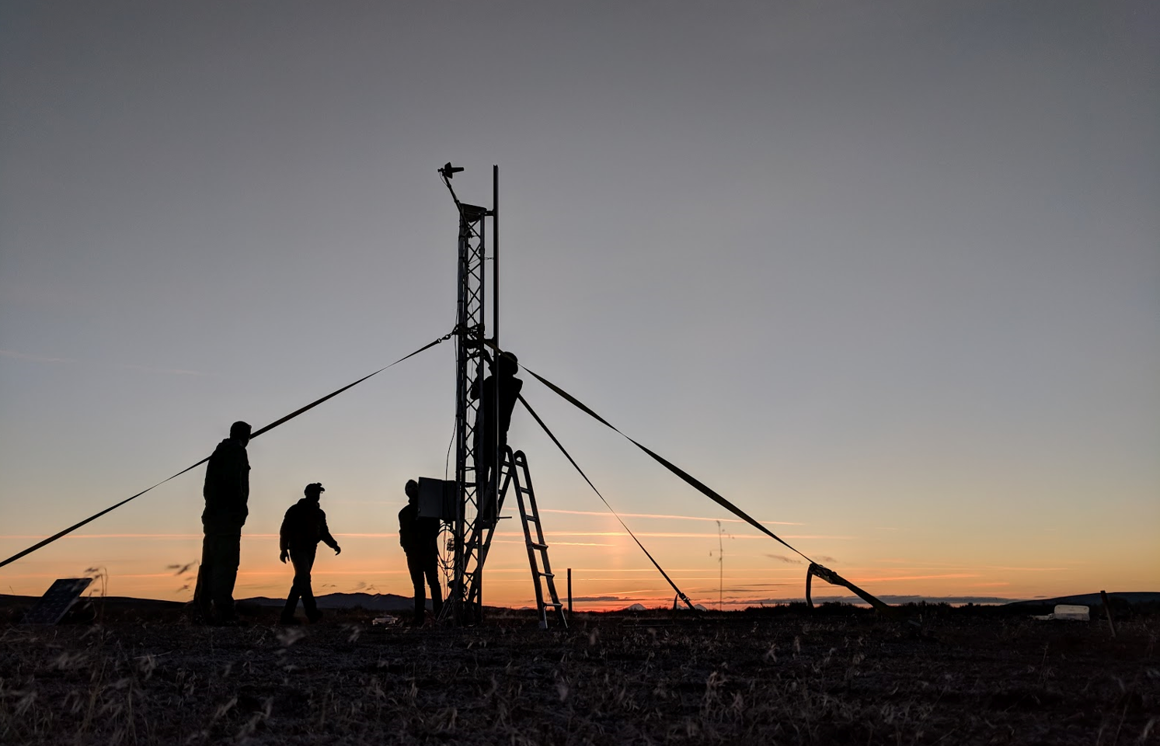
Flight Ready Electric Feed System
Project No. 13
Sponsored by PSAS, PSU, and Oregon NASA Space Grant Consortium

Slide 2

Winter 2019 updates
PSAS Electric Feed System
Design
CAD Models
Engineering Requirements
Manufacturing Strategy
Tolerances, Tooling and Material
Embedded Sensors Schematic
Project Schedule

Slide 3
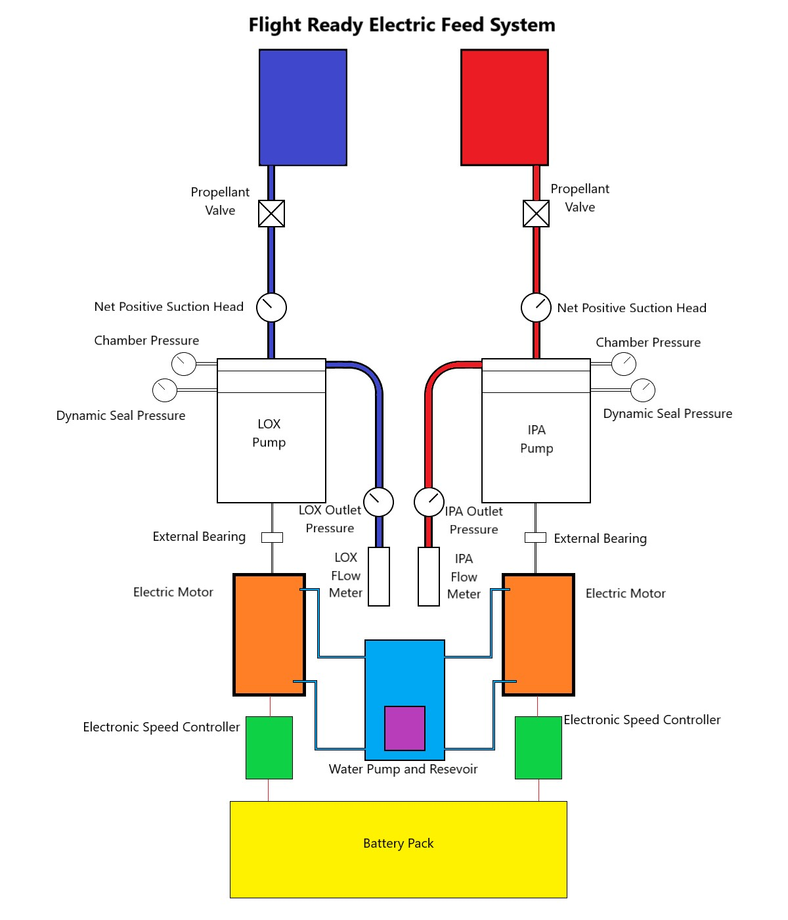
Electric Feed System
PSAS EFS System Overview

Slide 4
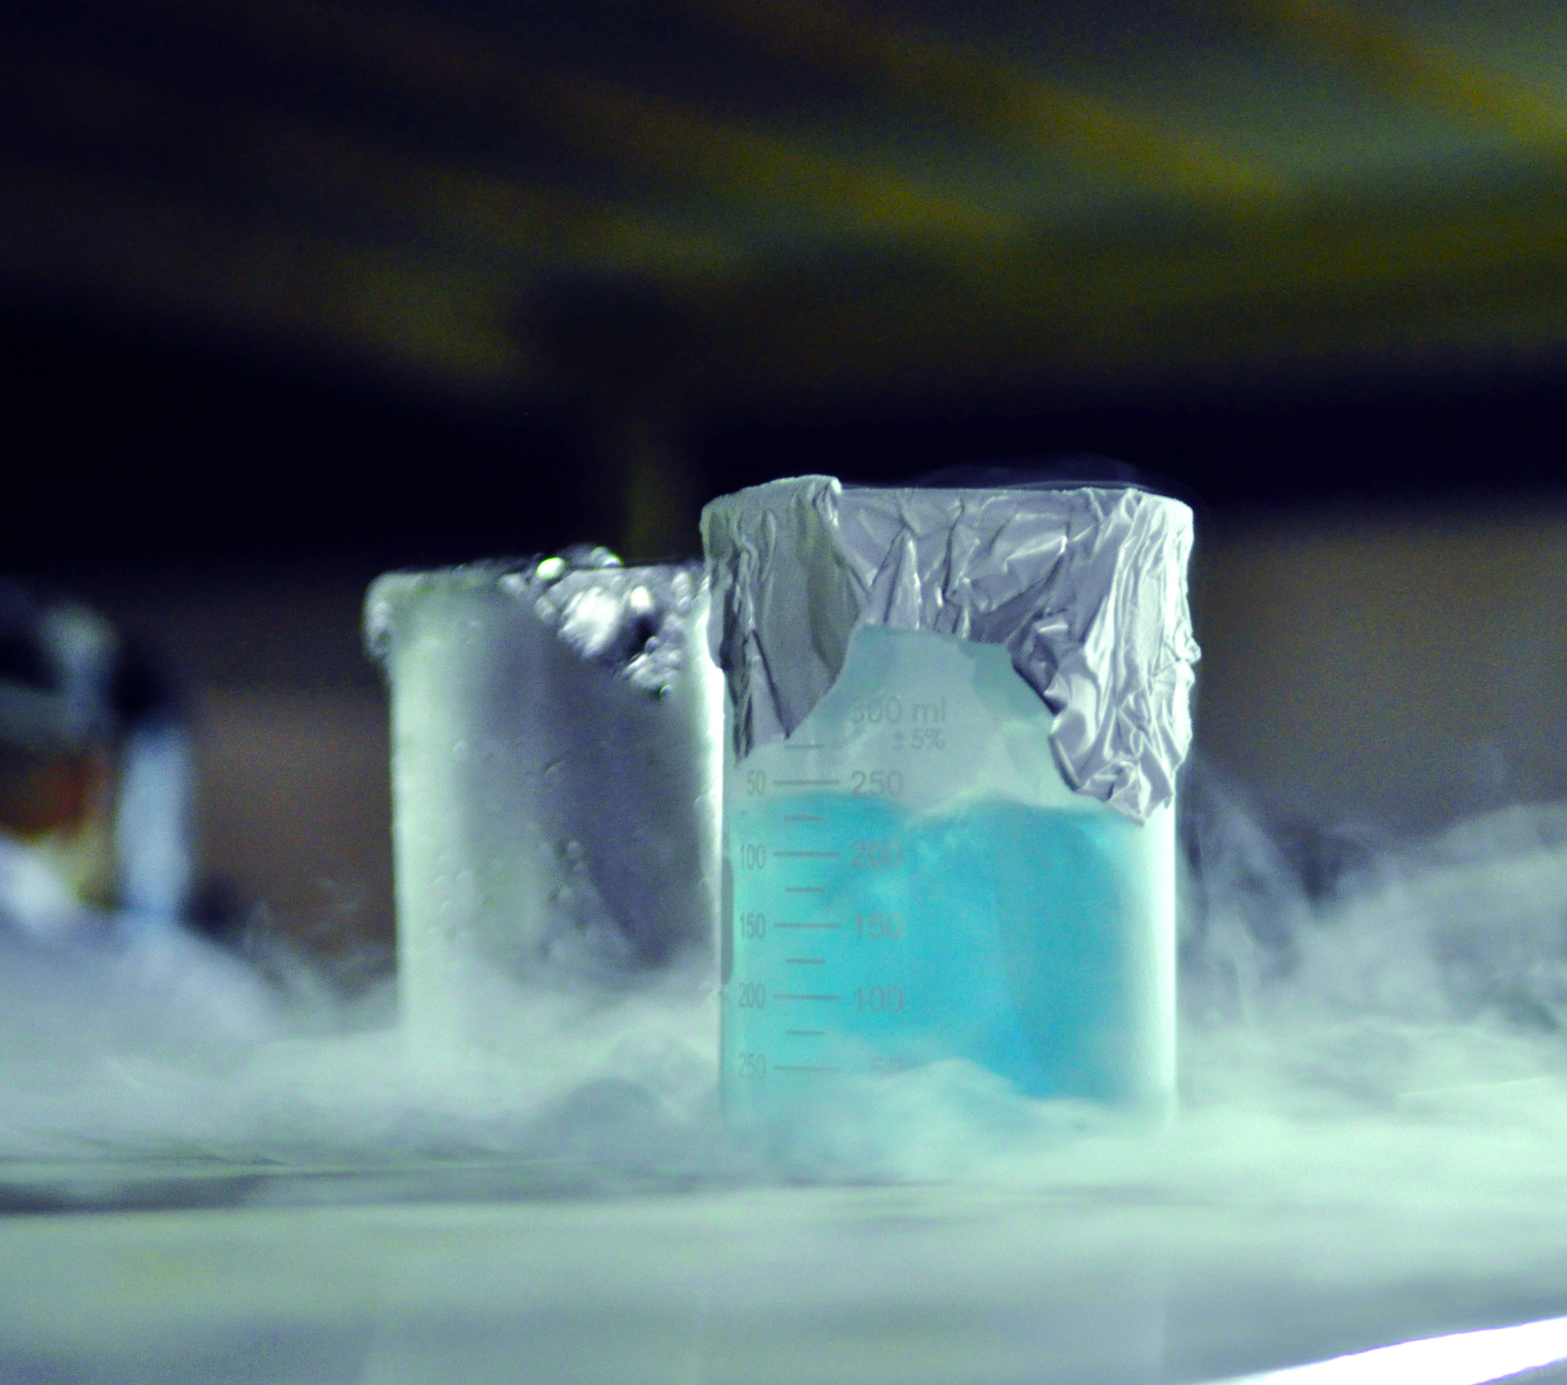
Customer Requirements
PSAS Electric Feed System
Compatibility Requirements
Liquid Oxygen (LOX)
Isopropyl Alcohol
Propellant Safety
Embedded Sensors
Chemical Safety Training for LOX

Slide 5
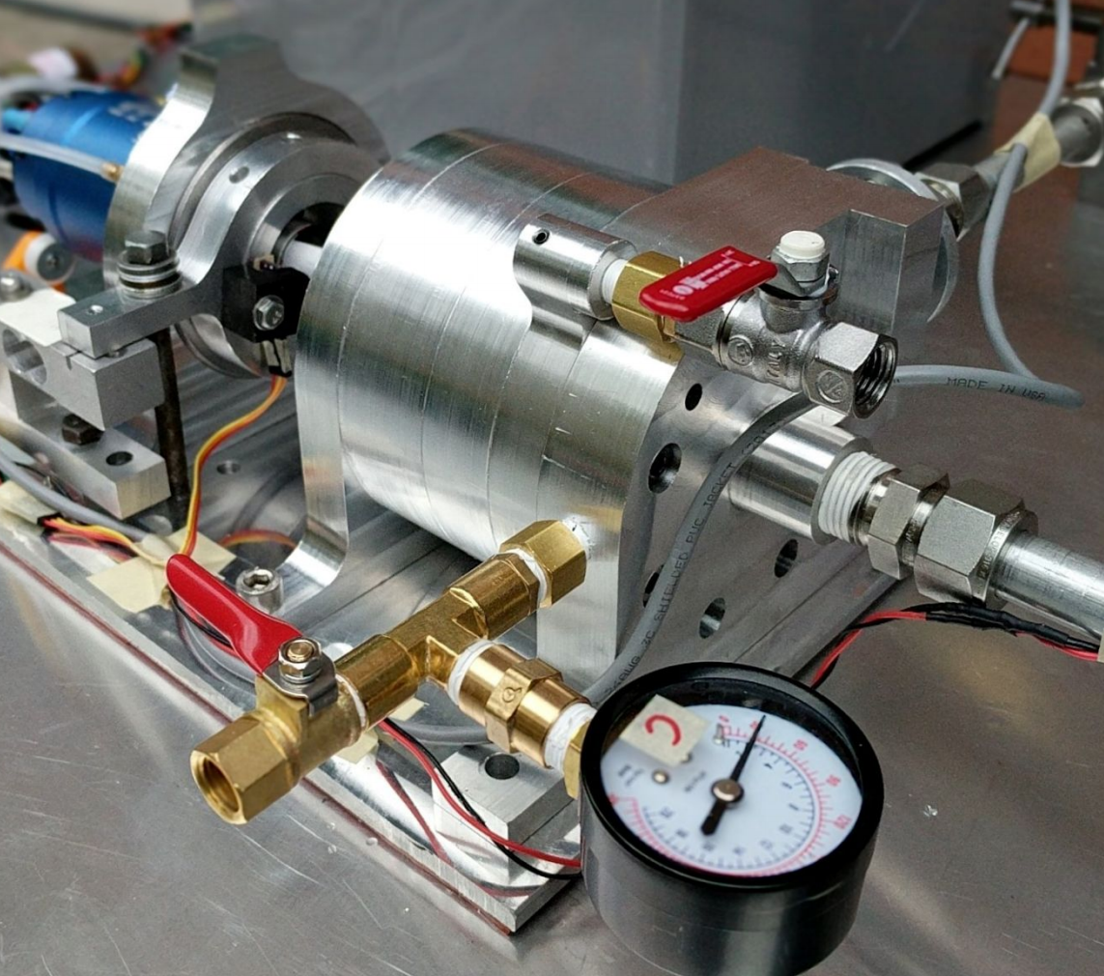
Engineering Requirements
Requirements | Units | Values
P | [psi] | 400
ṁ | [kg/s] | 2.07
Motor Power | [kW] | 5-6
Rotation Speed | [rpm] | 12k-22k
Thrust | [kN] | 2.2
Acceleration | [g] | 10
Airframe Diameter | [in] | 12
PSAS Electric Feed System

Slide 6
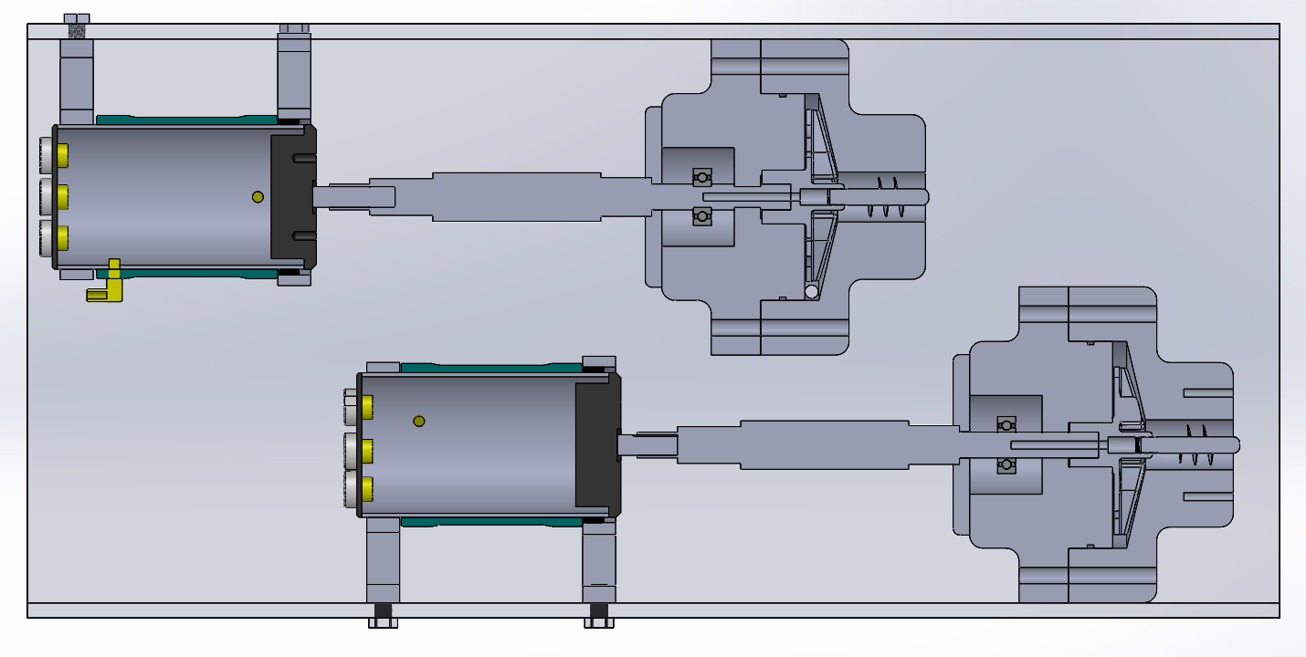
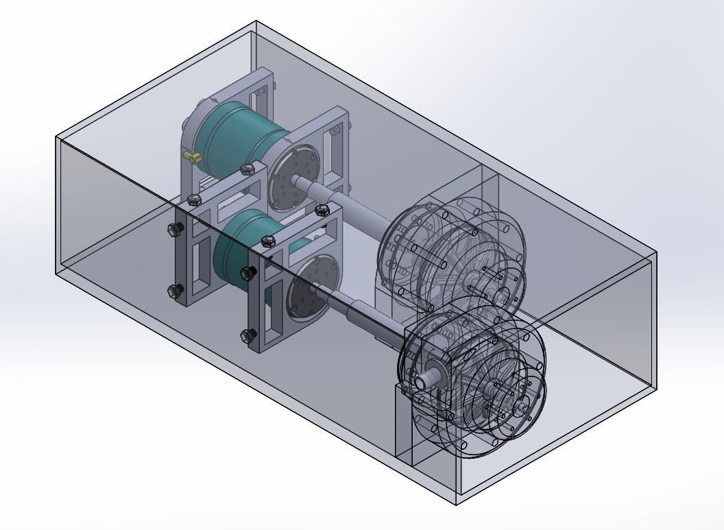
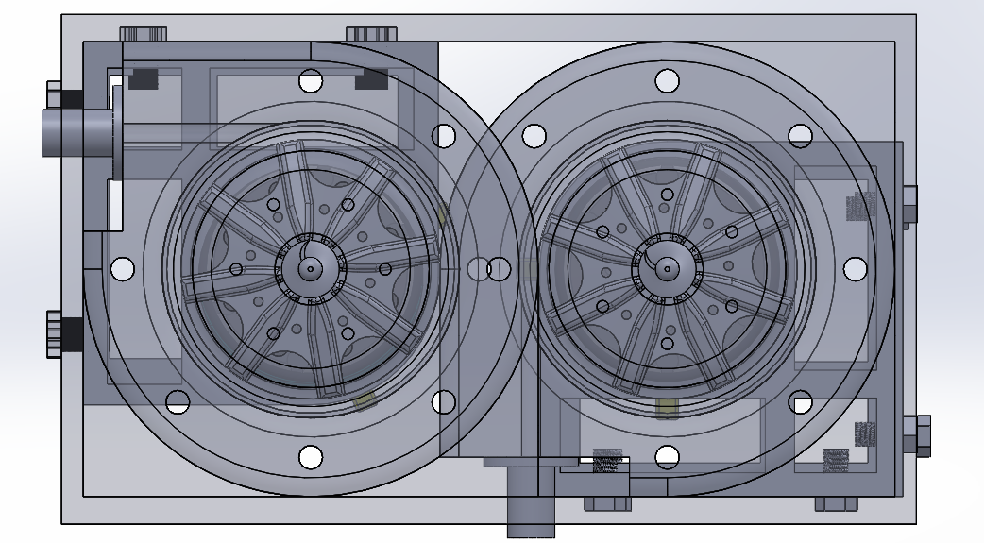
Design Concept

Slide 7
Milestones
PSAS Electric Feed System
January
February - March
April - May
June
Design & Concept
Manufacturing
Testing
Completion

